Slide 1
2
Derivatives
Copyright © Cengage Learning. All rights reserved.

Slide 2
Topics for this week
Derivative by laws, rules, theorems

Slide 3
Definition of Derivative(Review)
Definition derivative of f at a number a:
The derivative of a function f at a number a, denoted by
$$f^{′}\left(a\right)=\lim_{h→0}{\frac{f\left(a+h\right)−f(a)}{h}}$$
if this limit exists.
Definition The derivative function:
If we replace a in Equation 1 by a variable x, we obtain
$$f^{′}\left(x\right)=\lim_{h→0}{\frac{f\left(x+h\right)−f(x)}{h}}$$
We can regard
as a new function, called the derivative of f and defined

Slide 4
Derivative by laws, rules, theorems
Copyright © Cengage Learning. All rights reserved.

Slide 5
Differentiation Formulas
Copyright © Cengage Learning. All rights reserved.

Slide 6
Five Derivative Rules
$${\left(cf\left(x\right)\right)}^{′}=cf′(x)$$ | Constant Multiple rule
${\left(f(x)±g(x)\right)}^{′}=f^{′}(x)±g′(x)$ | Sum Rule and difference rule
$${\left(f(x)g(x)\right)}^{′}=f^{′}(x)g(x)+f(x)g′(x)$$ | Product Rule
$${\left(\frac{f(x)}{g(x)}\right)}^{′}=\frac{f^{′}(x)g(x)−f(x)g′(x)}{{g(x)}^{2}}$$ | Quotient Rule
$${\left(f(g(x)\right)}^{′}=f^{′}\left(g\left(x\right)\right)g′(x)$$ | Chain Rule

Slide 7
Five Derivative Rules(Another notation)
$$\frac{d}{dx}[cf\left(x\right)]=c\frac{d}{dx}[f\left(x\right)]$$ | Constant Multiple rule
$$\frac{d}{dx}[f\left(x\right)±g\left(x\right)]=\frac{d}{dx}[f\left(x\right)]±\frac{d}{dx}[g\left(x\right)]$$ | Sum Rule and difference rule
$$\frac{d}{dx}[f\left(x\right)g\left(x\right)]=\frac{d}{dx}[f\left(x\right)]g(x)+f\left(x\right)\frac{d}{dx}[g\left(x\right)]$$ | Product Rule
$$\frac{d}{dx}\left[\frac{f(x)}{g(x)}\right]=\frac{\frac{d}{dx}[f\left(x\right)]g(x)−f(x)\frac{d}{dx}[g\left(x\right)]}{{g(x)}^{2}}$$ | Quotient Rule
$$\frac{d}{dx}[f(g\left(x\right)]=\frac{d}{dg\left(x\right)}[f\left(g\left(x\right)\right)]\frac{d}{dx}[g(x)]$$ | Chain Rule

Slide 8
Some Known Results
(c)’ =0 | $$\left(x^{n}\right)′=nx^{n−1}$$
$$\left(e^{x}\right)′=e^{x}$$ | $$\left(a^{x}\right)′=a^{x}ln⁡(a)$$ | $$\left(ln⁡(x)\right)′=\frac{1}{x}$$ | $$\left(\log_{b}x\right)′=\frac{1}{x ln⁡(b)}$$
$$\left(\sin{x}\right)′=\cos{x}$$ | $$\left(\csc{x}\right)′=−csc{x\cot{x}}$$ | $${\left(\sin^{−1}{x}\right)}^{′}=\frac{1}{\sqrt{1−x^{2}}}$$ | $${\left(\csc^{−1}{x}\right)}^{′}=−\frac{1}{x\sqrt{x^{2}−1}}$$
$${\left(\cos{x}\right)}^{′}=−\sin{x}$$ | ${\left(\sec{x}\right)}^{′}=\sec{x}$tan x | $${\left(\cos^{−1}{x}\right)}^{′}=−\frac{1}{\sqrt{1−x^{2}}}$$ | $${\left(\sec^{−1}{x}\right)}^{′}=\frac{1}{x\sqrt{x^{2}−1}}$$
$${\left(\tan{x}\right)}^{′}=\sec^{2}x$$ | $${\left(\cot{x}\right)}^{′}={−csc}^{2}x$$ | $${\left(\tan^{−1}{x}\right)}^{′}=\frac{1}{1+x^{2}}$$ | $${\left(\cot^{−1}{x}\right)}^{′}=−\frac{1}{1+x^{2}}$$

Slide 9
Proof of Sum Rule
Let $F\left(x\right)=f\left(x\right)+g(x)$
F$′(x)=\lim_{h→0}{\frac{F\left(x+h\right)−F(x)}{h}}$
$=\lim_{h→0}{\frac{f\left(x+h\right)+g\left(x+h\right)−f\left(x\right)−g(x)}{h}}$
$=\lim_{h→0}{\frac{f\left(x+h\right)−f\left(x\right)+g\left(x+h\right)−g(x)}{h}}$
$=\lim_{h→0}\left[\frac{f\left(x+h\right)−f\left(x\right)}{h}+\frac{g\left(x+h\right)−g\left(x\right)}{h}\right]$
$=\lim_{h→0}\left[\frac{f\left(x+h\right)−f\left(x\right)}{h}\right]+\lim_{h→0}\left[\frac{g\left(x+h\right)−g\left(x\right)}{h}\right]$
$=f^{′}(x)+g′(x)$

Slide 10
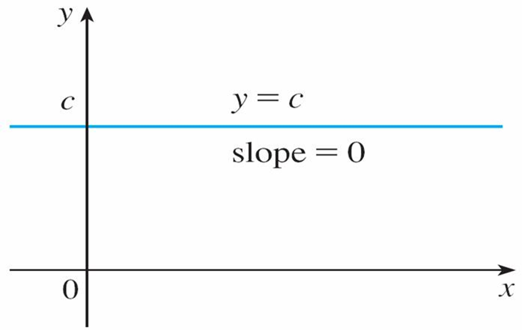
Proof of $c^{′}=0$
Let’s start with the simplest of all functions, the constant function f (x) = c.
The graph of this function is the horizontal line y = c, which has slope 0, so we must have
(See Figure 1.)
The graph of f (x) = c is the line y = c, so
Figure 1

Slide 11
Proof of $c^{′}=0$
A formal proof, from the definition of a derivative, is also easy:
In Leibniz notation, we write this rule as follows.
Derivative of a Constant Function

Slide 12
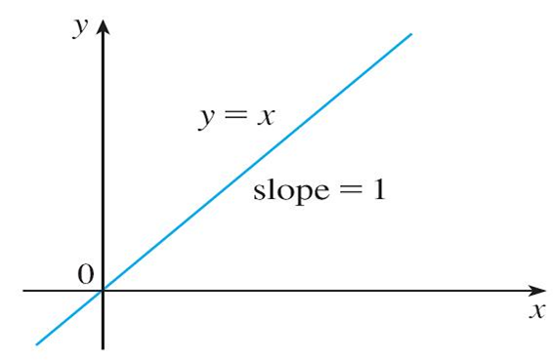
Proof of ${\left(x\right)}^{′}=1$ (graphical proof)
The graph of f (x) = x is the line y = x, which has slope 1. (See Figure 2.)
$$\frac{d}{dx}\left(x\right)=1$$
So
The graph of f (x) = x is the line y = x, so
Figure 2

Slide 13
Proof of ${\left(x\right)}^{′}=1$ (algebraic proof)
Let
$$f\left(x\right)=x$$
Then
$$f\left(x+h\right)=x+h$$
So
$$f^{′}\left(x\right)=\lim_{h→0}{\frac{f\left(x+h\right)−f(x)}{h} }$$
$$=\lim_{h→0}{\frac{x+h−x}{h} }$$
$$=\lim_{h→0}{\frac{h}{h} }$$
$$=\lim_{h→0}{1 }$$
$$=1$$

Slide 14
Proof of ${\left(x^{4}\right)}^{′}={4x}^{3}$
For n = 4 we find the derivative of
as follows:
$$\frac{d}{dx}\left(x^{4}\right)=4x^{3}$$

Slide 15
Power rule ${\left(x^{n}\right)}^{′}={nx}^{n−1}$
The Power Rule If n is a positive integer, then

Slide 16
General Power Functions
The Quotient Rule can be used to extend the Power Rule to the case where the exponent is a negative integer.
If n is a positive integer, then

Slide 17
General Power Functions
The Power Rule (General Version) If n is any real number, then

Slide 18
Derivatives of the Trigonometric Functions
Let’s show that if f(x) = sin x, then
From the definition of a derivative, we have

Slide 19
Derivatives of the Trigonometric Functions
Two of these four limits are easy to evaluate. Since we regard x as a constant when computing a limit as h → 0, we have

Slide 20
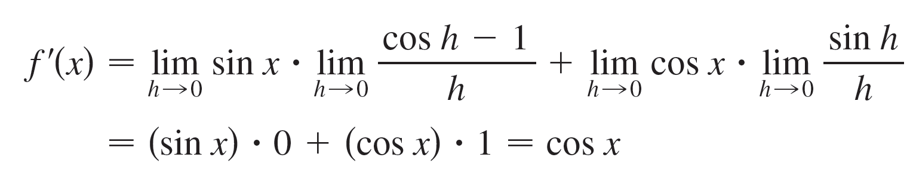
Derivatives of the Trigonometric Functions
Putting these limits into (1), we get
So we have proved the formula for the derivative of the sine function:
$$\frac{d}{dx}\left(\sin{x}\right)=\cos{x}$$

Slide 21
Derivatives of the Trigonometric Functions
Using the same methods as in the proof of Formula 2, we can prove that
The tangent function can also be differentiated by using the definition of a derivative, but it is easier to use the Quotient Rule together with Formulas 2 and 3:

Slide 22
Derivatives of the Trigonometric Functions

Slide 23
Derivatives of the Trigonometric Functions
We collect all the differentiation formulas for trigonometric functions in the following table. Remember that they are valid only when x is measured in radians.
Table of Derivatives of Trigonometric Functions

Slide 24
Derivatives of the Exponential Functions
Find the derivative function of
$$f(x)=e^{x}$$
Solution:
(a) From Definition of derivative of a function we have
$$f′(x)=\lim_{h→0}{\frac{f\left(x+h\right)−f(x)}{h}}$$
$$=\lim_{h→0}{\frac{e^{x+h}−e^{x}}{h}}$$
$$=\lim_{h→0}{\frac{e^{x}e^{h}−e^{x}}{h}}$$

Slide 25
Derivatives of the Exponential Functions
$$=\lim_{h→0}{\frac{e^{x}{(e}^{h}−1)}{h}}$$
$$=e^{x}\lim_{h→0}{\frac{e^{h}−1}{h}}$$
$$=e^{x}∙1$$
$$=e^{x}$$

Slide 26
Derivatives of the Logarithmic Functions
Find the derivative function of
$$f(x)=ln⁡(x)$$
Solution:
(a) From Definition of derivative of a function we have
$$f′(x)=\lim_{h→0}{\frac{f\left(x+h\right)−f(x)}{h}}$$
$$=\lim_{h→0}{\frac{ln⁡(x+h)−ln⁡(x)}{h}}$$
$$=\lim_{h→0}{\frac{\ln\left(\frac{x+h}{x}\right)}{h}}$$

Slide 27
Derivatives of the Logarithmic Functions
$$=\lim_{h→0}{\frac{\ln\left(1+\frac{h}{x}\right)}{h}}$$
$$=\lim_{h→0}{\frac{\ln\left(1+\frac{h}{x}\right)}{\frac{h}{x}∙x}}$$
$$=\frac{1}{x} \lim_{h→0}{\frac{\ln\left(1+\frac{h}{x}\right)}{\frac{h}{x}}}$$
$$Note: \lim_{x→0}{\frac{\ln\left(1+x\right)}{x}}=1$$
$$=\frac{1}{x}$$

Slide 28
Examples

Slide 29



Slide 30
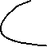




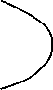

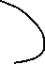




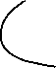


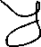

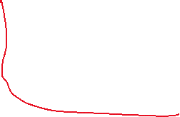

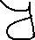
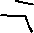

Slide 31









Slide 32


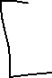



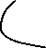







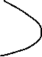

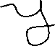

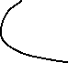



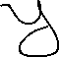
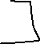





Slide 33


Slide 34

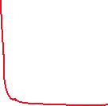

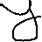

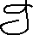


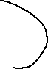




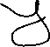






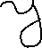

Slide 35





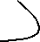


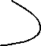
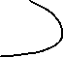





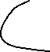
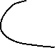
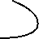


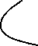





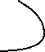

Slide 36


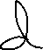

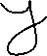




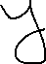
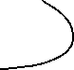

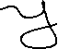





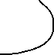


Slide 37




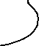


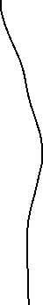



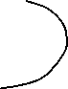

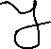
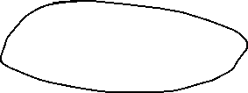

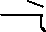
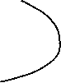
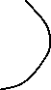


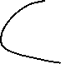
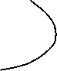
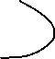






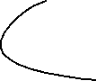






Slide 38






























Slide 39





























Slide 40



















Slide 41

























Slide 42






















Slide 43






















Slide 44

















Slide 45














Slide 46
























Slide 47




















Slide 48































Slide 49










Slide 50









Slide 51








Example 1(i)
(a) If
$$f\left(x\right)=x^{11}$$
then
$$f^{′}\left(x\right)=11x^{11−1}={11x}^{10}$$
(b) If
$$y=x^{1100}$$
then
$$y^{′}=1100x^{1100−1}={11x}^{1099}$$
(c) If
$$y=s^{8}$$
then
$$\frac{dy}{ds}=8x^{8−1}={8x}^{7}$$
$$\frac{d}{dr}\left(r^{3}\right)$$
(d)
$$=3r^{2}$$

Slide 52









Example 1(ii)
$$y=\frac{1}{x}$$
$$\frac{dy}{dx}=\frac{d}{dx}\left(x^{−1}\right)$$
(a) If
then
$$={−x}^{−2}$$
$$=−\frac{1}{x^{2}}$$
$$\frac{d}{dt}\left(\frac{8}{t^{4}}\right)$$
$$=\frac{d}{dt}\left(8t^{−4}\right)$$
(b)
$$=8\frac{d}{dt}\left(t^{−4}\right)$$
$$=8\left(−4\right)\left(t^{−4−1}\right)$$
$$=−\frac{32}{t^{5}}$$

Slide 53
Example 2
(a)
(b)

Slide 54



Example 3
$$\frac{d}{dx}\left(x^{9}+7x^{6}−5x^{2}+16x−4\right)$$
$$=\frac{d}{dx}\left(x^{9}\right)+\frac{d}{dx}\left(7x^{6}\right)+\frac{d}{dx}\left(−5x^{2}\right)+\frac{d}{dx}\left(16x\right)+\frac{d}{dx}\left(−4\right)$$
$$=\frac{d}{dx}\left(x^{9}\right)+7\frac{d}{dx}\left(x^{6}\right)−5\frac{d}{dx}\left(x^{2}\right)+16\frac{d}{dx}\left(x\right)+\frac{d}{dx}\left(−4\right)$$
$$={9x}^{8}+7\left(6x^{5}\right)−5\left(2x\right)+16(1)+0$$
$$={9x}^{8}+42x^{5}−10x+16$$

Slide 55
Example 4
Find
Solution:
By the Product Rule, we have

Slide 56





Example 4 : Another Way
Find
Solution:
F$′(x)=\left(\left(6x^{3}\right)\left(7x^{4}\right) \right)′$
$=\left(42x^{7} \right)′$
$=42\left(x^{7}\right)′$
$=42∙7x^{7−1}$
$=294x^{6}$

Slide 57









Example 5
Find
F’(x) if
F$\left(x\right)=x\cos{x}$
Solution:
F$′(x)=\left(x\cos{x}\right)′$
$$+$$
$$\cos{x}$$
$x$
$=\left(x \right)′$
$$\left(\cos{x} \right)′$$
$=1∙\cos{x+x\left(−\sin{x}\right)}$
$=\cos{x−x\sin{x}}$

Slide 58
Example 6
Differentiate the function
Solution 1:
Using the Product Rule, we have

Slide 59
Example 6 – Solution 2
If we first use the laws of exponents to rewrite f (t), then we can proceed directly without using the Product Rule.
which is equivalent to the answer given in Solution 1.

Slide 60





Example 7
$$y=\frac{x^{2}+x−2}{x^{3}+6}$$
Let
then
$$y′=\frac{{\left(x^{2}+x−2\right)}^{′}\left(x^{3}+6\right)−\left(x^{2}+x−2\right)\left(x^{3}+6\right)′}{{\left(x^{3}+6\right)}^{2}}$$
$$=\frac{\left(2x+1\right)\left(x^{3}+6\right)−\left(x^{2}+x−2\right)\left({3x}^{2}\right)}{{\left(x^{3}+6\right)}^{2}}$$
$$=\frac{\left(2x^{4}+x^{3}+12x+6\right)−\left({3x}^{4}+3x^{3}−6x^{2}\right)}{{\left(x^{3}+6\right)}^{2}}$$
$$=\frac{−x^{4}−2x^{3}+6x^{2}+12x+6}{{\left(x^{3}+6\right)}^{2}}$$

Slide 61
The Quotient Rule
Note:
Don’t use the Quotient Rule every time you see a quotient.
Sometimes it’s easier to rewrite a quotient first to put it in a form that is simpler for the purpose of differentiation.
For instance, although it is possible to differentiate the function
Using the Quotient Rule.

Slide 62
The Quotient Rule
It is much easier to perform the division first and write the function as
before differentiating.

Slide 63
Example 8
Find
Solution 1:
(Using Formula 1): We have expressed F as
Since
we have

Slide 64
Example 8 – Solution 2
(Using Formula 2): If we let

Slide 65







Example 8 – Solution 3
Find
F’(x) if
F$\left(x\right)=\sqrt{x^{2}+1}$
Solution:
Note: ${\left(\sqrt{x}\right)}^{′}={\left(x^{1/2}\right)}^{′}=\frac{1}{2\sqrt{x}}$
F$′(x)=\left(\sqrt{x^{2}+1}\right)′$
$=\frac{1}{2\sqrt{x^{2}+1}}$
$$\left(x^{2}+1\right)′$$
$=\frac{1}{2\sqrt{x^{2}+1}}2x$
$=\frac{x}{\sqrt{x^{2}+1}}$

Slide 66





Example 9
F$\left(x\right)=8xe^{x}+\frac{ln⁡(x)}{6x} − 2^{x}$
Find
F’(x) if
Solution:
F$′(x)=\left(8xe^{x}+\frac{ln⁡(x)}{6x}−2^{x}\right)′$
$={\left(8xe^{x}\right)}^{′}+{\left(\frac{\ln\left(x\right)}{6x}\right)}^{′}−\left(2^{x}\right)′$
$={8\left(xe^{x}\right)}^{′}+\frac{1}{6}{\left(\frac{\ln\left(x\right)}{x}\right)}^{′}−2^{x}ln⁡(2)$
Note: $\left(a^{x}\right)′=a^{x}ln⁡(a)$
$={8\left(x\right)}^{′}e^{x}+8x\left(e^{x}\right)′+\frac{1}{6}\frac{{\left(\ln\left(x\right)\right)}^{′}x−\ln\left(x\right)\left(x\right)′}{x^{2}}−2^{x}ln⁡(2)$

Slide 67

Example 9
$={8\left(x\right)}^{′}e^{x}+8x\left(e^{x}\right)′+\frac{1}{6}\frac{{\left(\ln\left(x\right)\right)}^{′}x−\ln\left(x\right)\left(x\right)′}{x^{2}}−2^{x}ln⁡(2)$
$=8e^{x}+8xe^{x}+\frac{1}{6}\frac{\frac{1}{x}x−\ln\left(x\right)∙1}{x^{2}}−2^{x}ln⁡(2)$
$=8e^{x}+8xe^{x}+\frac{1−\ln\left(x\right)}{6x^{2}}−2^{x}ln⁡(2)$

Slide 68
Example 10
Find
F’(x) if
F$\left(x\right)=5^{tan⁡(x)}$
Solution:
F$′(x)=\left(5^{tan⁡(x)}\right)′$
Note: $\left(a^{x}\right)′=a^{x}ln⁡(a)$
$=5^{tan⁡(x)}ln⁡(5)$
$$\left(tan⁡(x)\right)′$$
$=5^{tan⁡(x)}ln⁡(5)\sec^{2}(x)$

Slide 69

Example 10
Find
F’(x) if
F$\left(x\right)=5^{tan⁡(x)}$
Solution:
$$\frac{d}{dx}F(x)=\frac{d}{d(\tan\left(x\right))}\left(5^{tan⁡(x)}\right)∙\frac{d}{d(x)}\left(tan⁡(x)\right)$$
$$Note:\frac{dy}{dx}=\frac{dy}{du}∙\frac{du}{dx}$$
$=5^{tan⁡(x)}ln⁡(5)\sec^{2}(x)$

Slide 70


Chain Rule: another look
$$\frac{d}{d\left(e^{x}\right)}\sin\left(e^{x}\right)$$
$$\frac{d}{d\left(x\right)}e^{x}$$
$$\frac{d}{dx}\sin{x}=\cos{x}$$
$$\frac{d}{d\left(x\right)}\sin\left(e^{x}\right)=$$
$$\frac{d}{dy}\sin{y}=\cos{y}$$
$$=\cos\left(e^{x}\right)e^{x}$$
$$\frac{d}{d\left(y\right)}\sin\left(y\right)$$
$$\frac{d}{d\left(x^{2}\right)}\sin\left(x^{2}\right)=\cos\left(x^{2}\right)$$
$$\frac{d}{d\left(x\right)}\sin\left(y\right)=$$
$$\frac{dy}{dx}$$
$$\frac{d}{d\left(e^{x}\right)}\sin\left(e^{x}\right)=\cos\left(e^{x}\right)$$

Slide 71



Example 11
F$\left(x\right)=3 x {sec⁡(4}^{x})+\frac{\sin\left(x\right)}{x}$
Find
F’(x) if
Solution:
F$′(x)=\left(3 x {sec⁡(4}^{x})+\frac{\sin\left(x\right)}{x}\right)′$
$={\left(3 x {sec⁡(4}^{x})\right)}^{′}+{\left(\frac{\sin\left(x\right)}{x}\right)}^{′}$
$={3\left(x {sec⁡(4}^{x})\right)}^{′}+{\left(\frac{\sin\left(x\right)}{x}\right)}^{′}$
$={3\left(x\right)}^{′}{sec⁡(4}^{x})+3x\left({sec⁡(4}^{x})\right)′+\frac{{\left(\sin\left(x\right)\right)}^{′}x−\sin\left(x\right)\left(x\right)′}{x^{2}}$

Slide 72


Example 11
$={3\left(x\right)}^{′}{sec⁡(4}^{x})+3x\left({sec⁡(4}^{x})\right)′+\frac{{\left(\sin\left(x\right)\right)}^{′}x−\sin\left(x\right)\left(x\right)′}{x^{2}}$
$={3sec⁡(4}^{x})+3x{sec⁡(4}^{x}) tan{⁡(4}^{x}){⁡(4}^{x})′+\frac{\left(\cos{x }\right)x−\sin\left(x\right)}{x^{2}}$
$={3sec⁡(4}^{x})+3x{sec⁡(4}^{x}) tan{⁡(4}^{x}){⁡4}^{x}ln⁡(4)+\frac{\left(\cos{x }\right)x−\sin\left(x\right)}{x^{2}}$

Slide 73
Implicitly Defined Functions

Slide 74



Implicitly Defined Functions (1 of 5)
The functions that we have met so far can be described by expressing one variable explicitly in terms of another variable—for example,
or, in general, y = f(x).
Some functions, however, are defined implicitly by a relation between x and y such as
or

Slide 75
Implicitly Defined Functions (2 of 5)
In some cases it is possible to solve such an equation for y as an explicit function (or several functions) of x.
For instance, if we solve Equation 1 for y, we get
so two of the functions determined by the implicit Equation 1 are

Slide 76

Implicitly Defined Functions (3 of 5)
The graphs of f and g are the upper and lower semicircles of the circle
(See Figure 1.)
Figure 1

Slide 77

Implicitly Defined Functions (4 of 5)
It’s not easy to solve Equation 2 for y explicitly as a function of x by hand. (Even if we use technology, the resulting expressions are very complicated.)
Nonetheless, (2) is the equation of a curve called the folium of Descartes shown in Figure 2 and it implicitly defines y as several functions of x.
The folium of Descartes
Figure 2

Slide 78

Implicitly Defined Functions (5 of 5)
The graphs of three such functions are shown in Figure 3.
Graphs of three functions defined by the folium of Descartes
Figure 3
When we say that f is a function defined implicitly by Equation 2, we mean that the equation
is true for all values of x in the domain of f.

Slide 79
Implicit Differentiation

Slide 80
Implicit Differentiation (1 of 1)
Fortunately, we don’t need to solve an equation for y in terms of x in order to find the derivative of y. Instead we can use the method of implicit differentiation.
This consists of differentiating both sides of the equation with respect to x and
then solving the resulting equation for dy/dx.
In the examples and exercises of this section it is always assumed that the given equation determines y implicitly as a differentiable function of x so that the method of implicit differentiation can be applied.

Slide 81
Example 12
If
Then find an equation of the tangent to the circle
at the point (3, 4).
Solution 1:
Differentiate both sides of the equation

Slide 82














Slide 83




























Slide 84















Slide 85
Example 12 – Solution (1 of 3)
Remembering that y is a function of x and using the Chain Rule, we have
Thus
Now we solve this equation for

Slide 86
Example 12 – Solution (2 of 3)
At the point (3, 4) we have x = 3 and y = 4, so
An equation of the tangent to the circle at (3, 4) is therefore
Solution 2:
Solving the equation
for y, we get
The point (3, 4) lies on the upper semicircle
and so we consider
the function

Slide 87
Example 12 – Solution (3 of 3)
Differentiating f using the Chain Rule, we have
At the point (3, 4) we have
and, as in Solution 1, an equation of the tangent is 3x + 4y = 25.

Slide 88
Example 13
$$\frac{dy}{dx}$$
$$y^{′}$$
$$y^{3}+xy=3 x^{2}$$
Find or if
Solution 1:
$$y^{3}+xy=3 x^{2}$$
$$\frac{d}{dx}\left(y^{3}+xy\right)=\frac{d}{dx}\left(3 x^{2}\right)$$
$$\frac{d}{dx}\left(y^{3}\right)+\frac{d}{dx}\left(xy\right)=3\frac{d}{dx}\left(x^{2}\right)$$
$$\frac{d}{dy}\left(y^{3}\right)\frac{dy}{dx}+\frac{d}{dx}\left(x\right)∙y+x\frac{dy}{dx}=3\left(2x\right)$$

Slide 89
Example 13
$$\frac{d}{dy}\left(y^{3}\right)\frac{dy}{dx}+\frac{d}{dx}\left(x\right)∙y+x\frac{dy}{dx}=3\left(2x\right)$$
3$y^{2}\frac{dy}{dx} +y +x\frac{dy}{dx}=6x$
$$\left(3y^{2}+x\right)\frac{dy}{dx}=6x−y$$
$$\frac{dy}{dx}=\frac{6x−y }{3y^{2}+x}$$

Slide 90
Example 13
$$\frac{dy}{dx}$$
$$y^{′}$$
$$y^{3}+xy=3 x^{2}$$
Find or if
Solution 2:
$$y^{3}+xy=3 x^{2}$$
$${\left(y^{3}+xy\right)}^{′}={\left(3 x^{2}\right)}^{′}$$
$${\left(y^{3}\right)}^{′}+{\left(xy\right)}^{′}=3{\left(x^{2}\right)}^{′}$$
$$3y^{2}y^{′}+{\left(x\right)}^{′}y+xy^{′}=3\left(2x\right)$$

Slide 91
Example 13
$$3y^{2}y^{′}+{\left(x\right)}^{′}y+xy^{′}=3\left(2x\right)$$
$$3y^{2}y^{′}+y+xy^{′}=6x$$
$$3y^{2}y^{′}+xy^{′}=6x−y$$
$$\left(3y^{2}+x\right)y^{′}=6x−y$$
$$y^{′}=\frac{6x−y }{3y^{2}+x}$$

Slide 92
Example 14
$$\frac{dy}{dx}$$
$$y^{′}$$
$$\sin{y+}x^{5}=y^{4}+7x$$
Find or if
$$\sin{y+}x^{5}=y^{4}+7x$$
$${\left(\sin{y+}x^{5}\right)}^{′}={\left(y^{4}+7x \right)}^{′}$$
${\left(\sin{y}\right)}^{′}+{\left(x^{5}\right)}^{′}={\left(y^{4}\right)}^{′}$+${\left(7x \right)}^{′}$
$${\cos{y∙}y}^{′}+5x^{4}={4y}^{3}y^{′}+7$$

Slide 93
Example 14
$${\cos{y∙}y}^{′}+5x^{4}={4y}^{3}y^{′}+7$$
$${\cos{y∙}y}^{′}−{4y}^{3}y^{′}=7 − 5x^{4}$$
$$\left(\cos{y}−{4y}^{3}\right)y^{′}=7 − 5x^{4}$$
$$y^{′}=\frac{7 − 5x^{4}}{\cos{y}−{4y}^{3}}$$

Slide 94
Example 15
$$\frac{dy}{dx}$$
$$y^{′}$$
$$e^{y}+xy^{2}=2 x^{3}$$
Find or if
Solution:
$$e^{y}+xy^{2}=2 x^{3}$$
$${\left(e^{y}+xy^{2}\right)}^{′}={\left(2 x^{3}\right)}^{′}$$
$${\left(e^{y}\right)}^{′}+{\left(xy^{2}\right)}^{′}=2{\left(x^{3}\right)}^{′}$$
$$e^{y}y^{′}+{\left(x\right)}^{′}y^{2}+x{\left(y^{2}\right)}^{′}=2\left(3x^{2}\right)$$

Slide 95
Example 15
$$e^{y}y^{′}+{\left(x\right)}^{′}y^{2}+x{\left(y^{2}\right)}^{′}=2\left(3x^{2}\right)$$
$$e^{y}y^{′}+y^{2}+x{2yy}^{′}=6x^{2}$$
$$e^{y}y^{′}+2xyy^{′}=6x^{2}−y^{2}$$
$$(e^{y}+2xy{)y}^{′}=6x^{2}−y^{2}$$
$$y^{′}=\frac{6x^{2}−y^{2} }{e^{y}+2xy}$$

Slide 96
Example 16
$$\frac{dy}{dx}$$
$$y^{′}$$
$$y=x^{x}$$
Find or if
$=e^{x ln(x)}$
Solution 1:
$$y=x^{x}$$
$$y^{′}={\left(e^{x ln(x)}\right)}^{′}$$
$$=e^{x ln(x)}$$
$${\left(x ln(x)\right)}^{′}$$
$$\left({\left(x\right)}^{′} ln\left(x\right)+x{\left(ln\left(x\right)\right)}^{′}\right)$$
$$=e^{x ln(x)}$$
$$\left( ln\left(x\right)+x\frac{1}{x}\right)$$
$$=e^{x ln(x)}$$
$$=x^{x}$$
$$\left( ln\left(x\right)+1\right)$$

Slide 97
Example 16
$$\frac{dy}{dx}$$
$$y^{′}$$
$$y=x^{x}$$
Find or if
Solution 2:
$$ln⁡(y)=ln⁡(x^{x})$$
$$ln⁡(y)=xln⁡(x)$$
$${\left(ln⁡(y)\right)}^{′}={\left(xln⁡(x) \right)}^{′}$$
$$\frac{1}{y}y^{′}=$$
$${\left(x\right)}^{′} ln\left(x\right)+x{\left(ln\left(x\right)\right)}^{′}$$
$$=ln\left(x\right)+x\frac{1}{x}$$
$$y^{′}=y\left( ln\left(x\right)+1\right)$$
$$y^{′}=x^{x}\left( ln\left(x\right)+1\right)$$

Slide 98
Example 17
$${\left(\sin^{−1}{x}\right)}^{′}=\frac{1}{\sqrt{1−x^{2}}}$$
Prove that us$i$ng $i$mpl$i$c$i$t d$i$fferent$i$at$i$on
$$y=\sin^{−1}{x}$$
Solution : Let
Then
$$\sin{(y)}=\sin{(\sin^{−1}{x})}$$
$$\sin{(y)}=x$$
$$\sin{{\left(y\right)}^{′}}=x^{′}$$
$$\cos\left(y\right)y^{′}=1$$
$$y^{′}=\frac{1}{\cos\left(y\right)}$$
$$=\frac{1}{\sqrt{1−\sin^{2}y}}$$
$$=\frac{1}{\sqrt{1−x^{2}}}$$

Slide 100




















Application of Implicit Differentiation

Slide 101



















Slide 102















Slide 103



Slide 104



























Slide 105












Slide 106
























Slide 107













Slide 108










Slide 109










Slide 110





















Slide 111









Slide 112


